Slide 1
GuardianEye
Stay Secure, Stay Confident.

Slide 2
WELCOME TO UUB
Union United Bank is a renowned financial institution and known for its community’s trust.

Slide 3

GuardianEye
The latest detection and prevention of fraud and identity theft in online banking system.

Slide 4
New Era in Detection
Behavioural Biometrics Fraud Detection
Real-time Behavioural and Transaction Analysis
No Security Compromises or Third-party Access
01
02
03

Slide 5
BEHOLD
The Newest Fighter in the Fraud Detection Arena

Slide 6
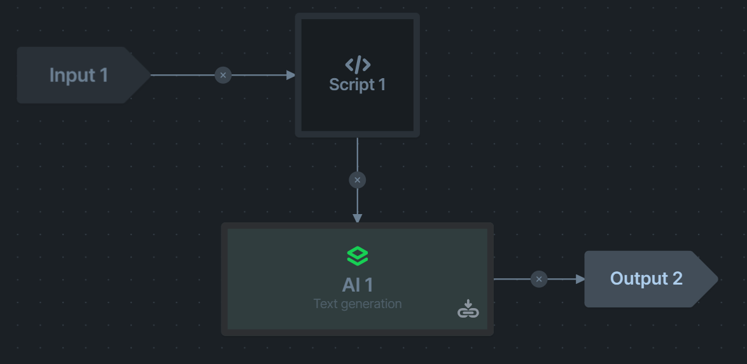
In Depth

Slide 8
Behind The Scenes

Slide 9

Aboard The Journey
Sensing the User’s Intercation with the Screen
Recognise Patterns and Compare to Fraud
Reading
Pattern
1
2
3
Analysis
Analyzing the Behaviour of the User

Slide 10
Where The Magic Happens
Detecting Abnormal Behaviour from the User
Abnormality
4
5
Bank Notification
Report
Generating a Case Based Report on the Incident

Slide 11
Infrastructure
Machine Learning Model
AWS
Cloud
Gen AI model to analyse, recognise, and generate incident reports to institutions
A cloud native system to insure scalability, efficiency and the handling of Big Data processing.

Slide 12
Why?

Slide 13
$9.3 Billion
2022 (Juniper Research)

Slide 14
1,000,00 Cases
27,200,00 Cases
$8.8 Billion
In the United States (2022)
In India (2022)
In loses (2022)

Slide 15
Target Market
Banks
Wallets
Retailers
Financial Institutions and Large Banks will be a long term customer.
Zain Cash, Orange Money, and Uwallet are a few of the wallet customer segment
Large corporations such as Safeway, Miles, and Family Basket could utilize the system in their ERP Systems

Slide 16
Competition
70%
50%
20%
Limited
Targeted
Real-Time
Focuses on one feature only
Services specific brands
Instant detection
Safer
Faster
Inclusive
Complete

Slide 17
Annual Plans
Phase | Cost : Profit | Period
Production |  | Year 1
Reinvestment |  | Year 2
Market Share |  | Year 3
Expansion |  | Year 4
90%
64%
50 %
30%

Slide 18
Future Outlook
Inclusion in the Bank’s System
Trace Intention
Transaction
Integration
01
02
03
04
Facial
In-House
Recognise User
On Premise Hosting

Slide 19
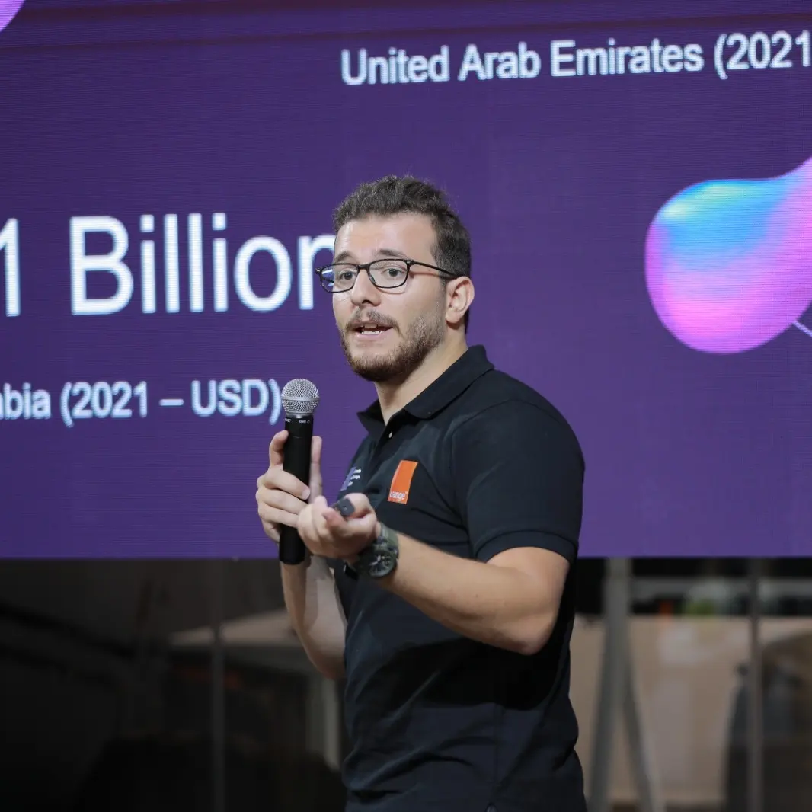
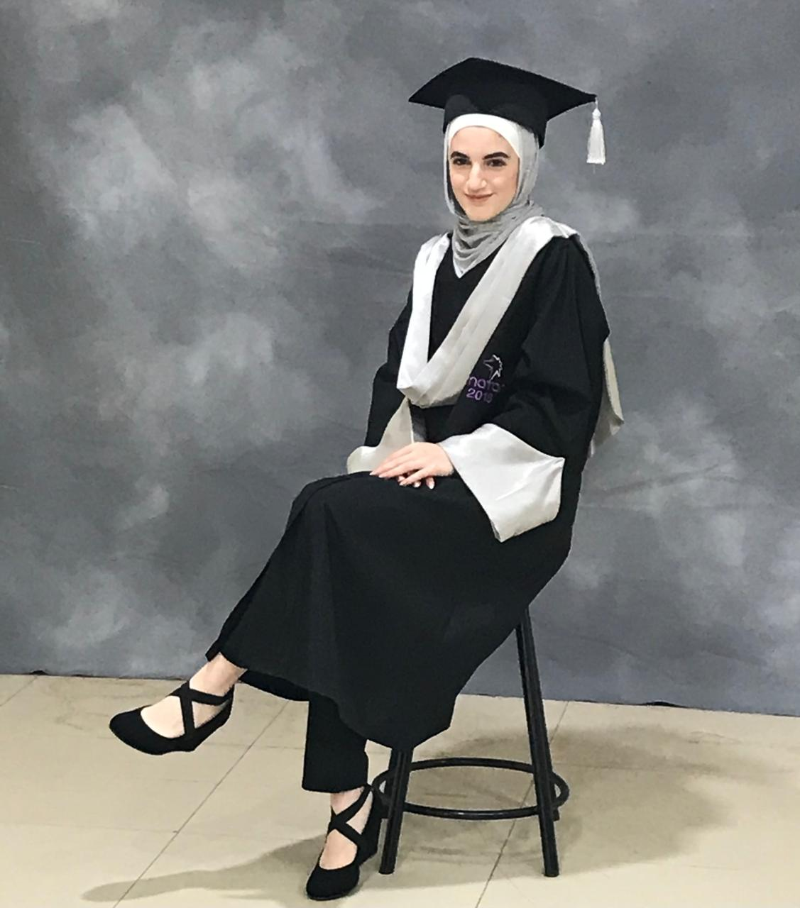
GuardianEye Team
Mohammad Abu Arida
Reem Jarrar
Software Engineering
Software Engineering

Slide 20
THANK YOU
GuardianEye
Stay Secure, Stay Confident.

